Slide 1
Computer Vision and Image Processing
Tirgul 10
2D Transformations
& Moriya Bitton

Slide 2
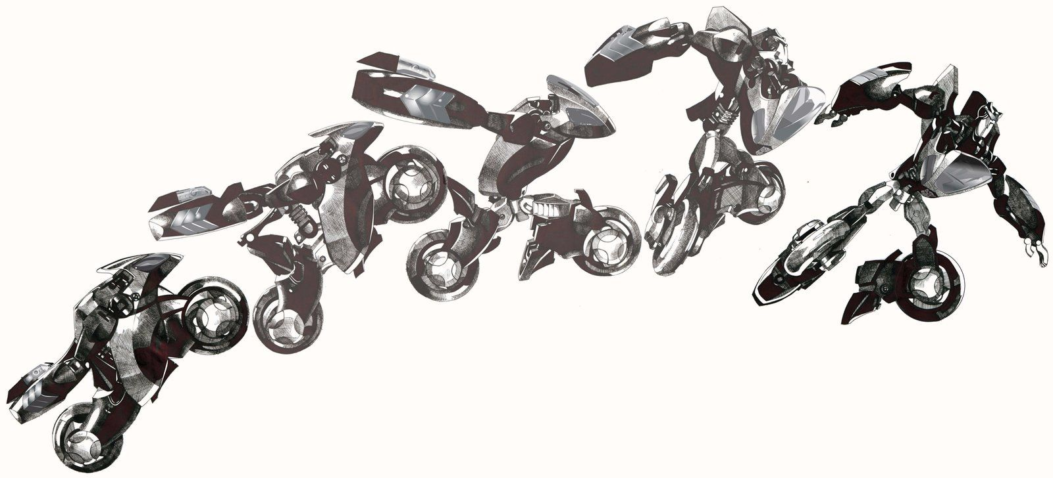
2D Transformation

Slide 3
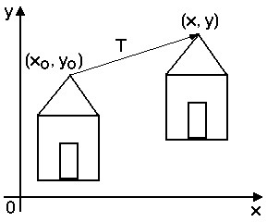
What is 2D transformation?
Let’s take for example: Translation

Slide 4
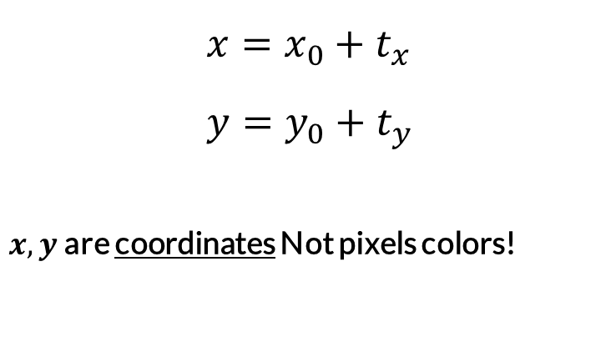
What is 2D transformation?
$$x=x_{0}+t_{x} \\ y=y_{0}+t_{y}$$
$x,y$are coordinates Not pixels colors!

Slide 5
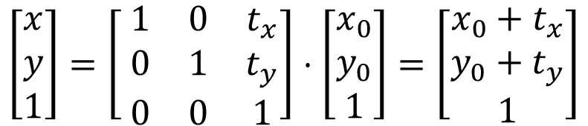
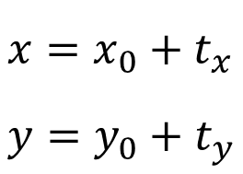
Matrix form
$$x=x_{0}+t_{x} \\ y=y_{0}+t_{y}$$
$$\left[\begin{aligned}x \\ y \\ 1\end{aligned}\right]=\left[ \begin{matrix}1 & 0 & t_{x} \\ 0 & 1 & t_{y} \\ 0 & 0 & 1\end{matrix}\right]⋅\left[\begin{aligned}x_{0} \\ y_{0} \\ 1\end{aligned}\right]=\left[\begin{aligned}x_{0}+t_{x} \\ y_{0}+t_{y} \\ 1\end{aligned}\right]$$

Slide 6

How to transform an image?
In code:
$$I^{′}\left(x,y\right)=I\left(x−t_{x},y−t_{y}\right)$$
newI = np.zeros_like(I)
h, w = newI.shape
for x_idx in range(w):
for y_idx in range(h):
newI[y_idx, x_idx] = I[y_idx - t_y, x_idx - t_x]

Slide 7
Let’s optimize that
Pixels indices (NOT COLORS)
X indices
0,0
0,1
0,2
0,3
0,4
0,5
0
1
2
1,0
1,1
0
1
2
0
1
2
Shape→(rows,cols,3)
0
1
2
Y indices
0
0
1
1
2
2
3rd channel is all 1’s.
3
3

Slide 8
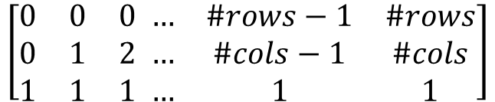
Let’s optimize that
Reshape: (3, rows*cols)
Shape→(rows,cols,3)
$$\left[\begin{matrix}0 & 0 & 0 \\ 0 & 1 & 2 \\ 1 & 1 & 1\end{matrix} \begin{matrix}… & \#rows−1 & \#rows \\ … & \#cols−1 & \#cols \\ … & 1 & 1\end{matrix}\right]$$

Slide 9
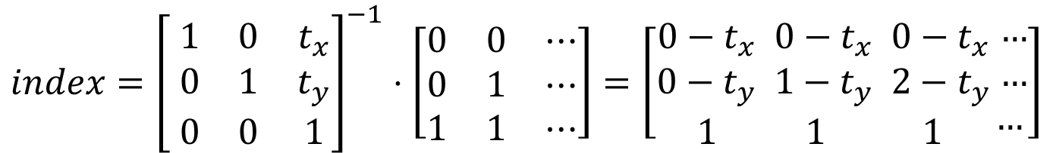
Let’s optimize that
Why inverse?
$$index={\left[ \begin{matrix}1 & 0 & t_{x} \\ 0 & 1 & t_{y} \\ 0 & 0 & 1\end{matrix}\right]}^{−1}⋅\left[\begin{matrix}0 & 0 & ⋯ \\ 0 & 1 & ⋯ \\ 1 & 1 & ⋯\end{matrix}\right]=\left[\begin{aligned}0−t_{x} \\ 0−t_{y} \\ 1\end{aligned}\begin{aligned} 0−t_{x} \\ 1−t_{y} \\ 1\end{aligned}\begin{aligned} 0−t_{x} \\ 2−t_{y} \\ 1\end{aligned}\begin{aligned} … \\ … \\ …\end{aligned}\right]$$

Slide 10
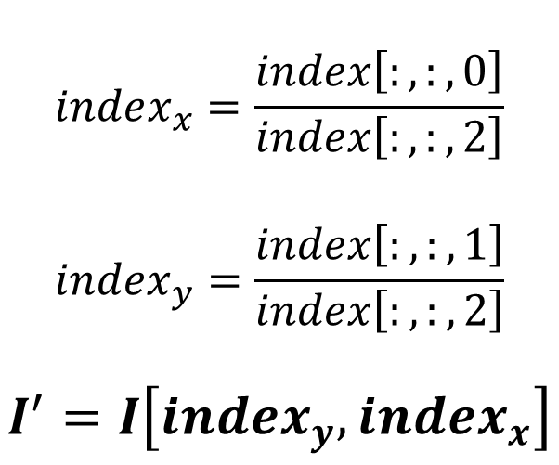
Let’s optimize that
$$index_{x}=\frac{index\left[:,:,0\right]}{index\left[:,:,2\right]}$$
$$index_{y}=\frac{index\left[:,:,1\right]}{index\left[:,:,2\right]}$$
$$I^{′}=I\left[index_{y},index_{x}\right]$$

Slide 11
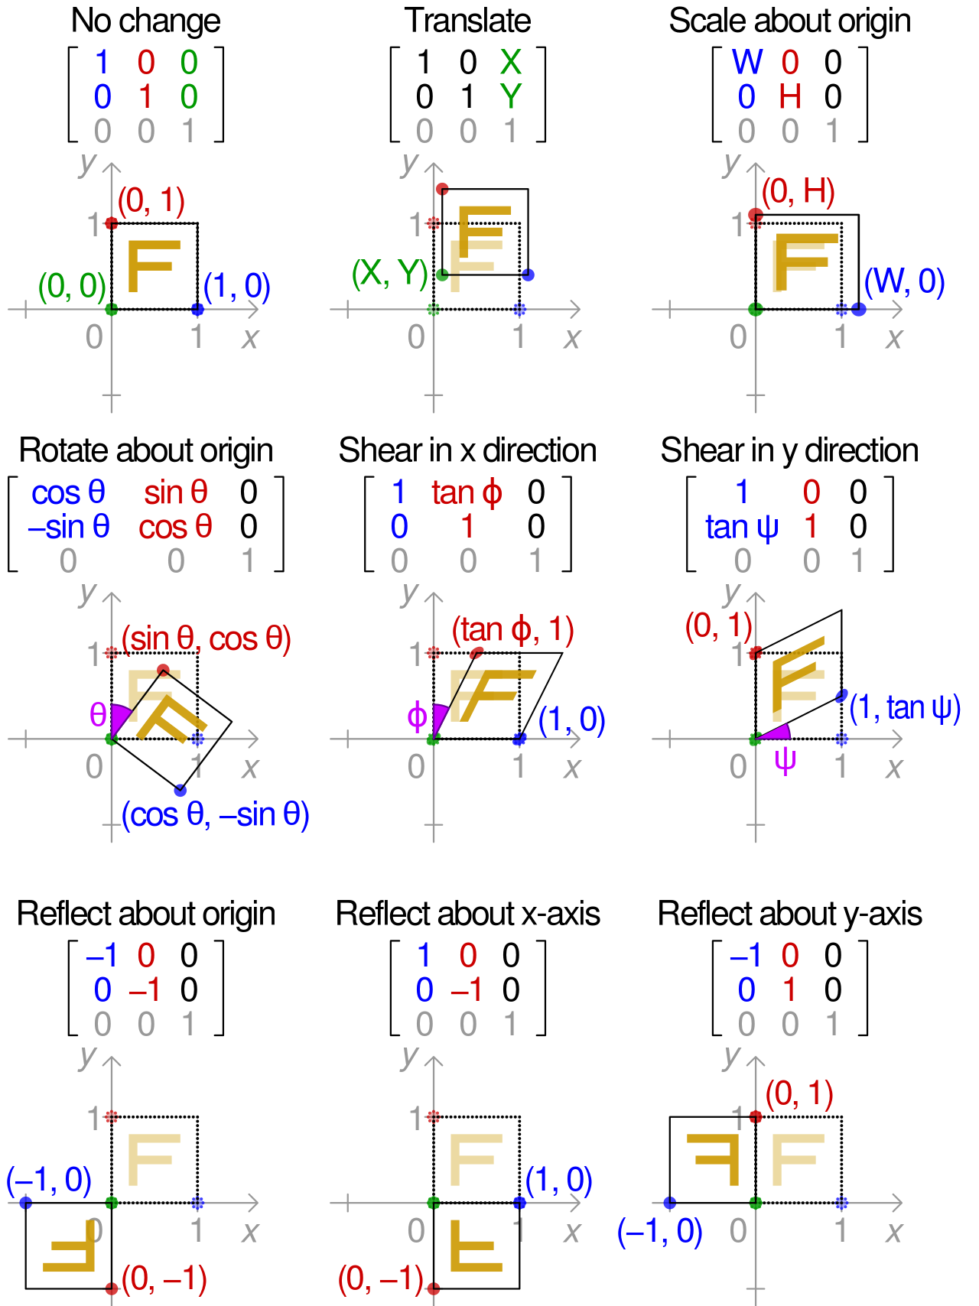
More transformations

Slide 12
Order of transformations
All transformations are relative to the (0, 0).
Let’s do a rotation (R) transformation:

Slide 13
Order of transformations
Again, but now the center of the square will be at (x, y) and not (0, 0).
Let’s do a rotation (R) transformation:
(x, y)

Slide 14
Order of transformations
How do we rotate the square in place?
?

Slide 15
Order of transformations
Add Translation!
Remember, The Order Of Operations Matter!!
R
T
-T

Slide 16

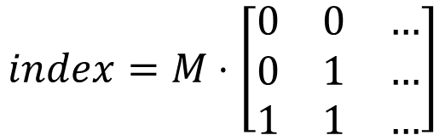
Transformation ‘chaining’
$$M={\left(T ⋅R⋅T^{−1}\right)}^{−1}$$
$$index=M⋅\left[\begin{matrix}0 & 0 & … \\ 0 & 1 & … \\ 1 & 1 & …\end{matrix}\right]$$

Slide 17
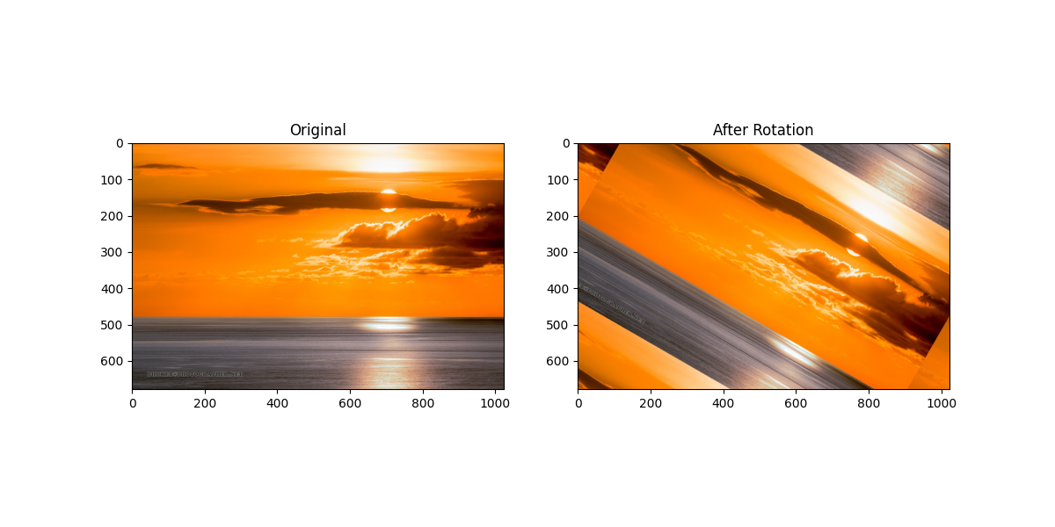
Code

